Slide 1
Programming model
Module iv

Slide 2
Parallel computing on a single computer uses multiple processors to process tasks in parallel,
distributed parallel computing uses multiple computing devices to process those tasks.
Parallel computing is the simultaneous use of more than one computational engine (not necessarily connected via a network) to run a job or an application.

Slide 3
Partitioning
This is applicable to both computation and data
Computation partitioning
Data partitioning
Mapping
Synchronization
Communication
Scheduling

Slide 4
Computation partitioning
This splits a given job or a program into smaller tasks. Partitioning greatly depends on correctly identifying portions of the job or program that can be performed concurrently.

Slide 5
Data partitioning This splits the input or intermediate data into smaller pieces. Similarly, upon identification of parallelism in the input data, it can also be divided into pieces to be processed on different workers.
Mapping This assigns the either smaller parts of a program or the smaller pieces of data to underlying resources. This process aims to appropriately assign such parts or pieces to be run simultaneously on different workers and is usually handled by resource allocators in the system.

Slide 6
Synchronization Because different workers may perform different tasks, synchronization and coordination among workers is necessary so that race conditions are prevented and data dependency among different workers is properly managed.
Communication Because data dependency is one of the main reasons for communication among workers, communication is always triggered when the intermediate data is sent to workers.

Slide 7
Scheduling For a job or program, when the number of computation parts (tasks) or data pieces is more than the number of available workers, a scheduler selects a sequence of tasks or data pieces to be assigned to the workers.
the resource allocator performs the actual mapping of the computation or data pieces to workers, while the scheduler only picks the next part from the queue of unassigned tasks based on a set of rules called the scheduling policy.

Slide 8
Hadoop
Open Source Apache Project
Hadoop Core includes
Hadoop Distributed File System (HDFS) – distributes data
Map/Reduce – distributes application
Written in Java
Runs on Linux, Mac OS/X, Windows, and Solaris

Slide 9
hadoop
Hadoop is a framework of the open source set of tools distributed under Apache License. It is used to manage data, store data, and process data for various big data applications running under clustered systems. In the previous years, Big Data was defined by the “3Vs” but now there are “5Vs” of Big Data which are also termed as the characteristics of Big Data.

Slide 10
Hadoop cluster is a special type of computational cluster designed for storing and analyzing vast amount of unstructured data in a distributed computing environment. These clusters run on low cost commodity computers.

Slide 11
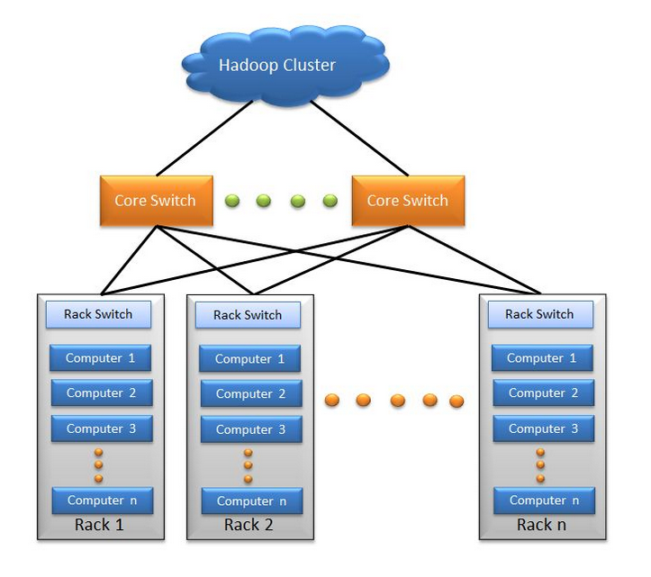

Slide 12
5 V’s
Volume: With increasing dependence on technology, data is producing at a large volume. Common examples are data being produced by various social networking sites, sensors, scanners, airlines and other organizations.
Velocity: Huge amount of data is generated per second. It is estimated that by the end of 2020, every individual will produce 3mb data per second. This large volume of data is being generated with a great velocity.

Slide 13
Variety: The data being produced by different means is of three types:
Structured Data: It is the relational data which is stored in the form of rows and columns.
Unstructured Data: Texts, pictures, videos etc. are the examples of unstructured data which can’t be stored in the form of rows and columns.
Semi Structured Data: Log files are the examples of this type of data.

Slide 14
Veracity: The term Veracity is coined for the inconsistent or incomplete data which results in the generation of doubtful or uncertain Information. Often data inconsistency arises because of the volume or amount of data e.g. data in bulk could create confusion whereas less amount of data could convey half or incomplete Information.
Value: After having the 4 V’s into account there comes one more V which stands for Value!. Bulk of Data having no Value is of no good to the company, unless you turn it into something useful. Data in itself is of no use or importance but it needs to be converted into something valuable to extract Information

Slide 15
HDFS is used to store the data, Map Reduce is used to process the data.
Components of Hadoop: Hadoop has three components:
HDFS: Hadoop Distributed File System is a dedicated file system to store big data with a cluster of commodity hardware or cheaper hardware with streaming access pattern. It enables data to be stored at multiple nodes in the cluster which ensures data security and fault tolerance.

Slide 16
Map Reduce : Data once stored in the HDFS also needs to be processed upon. Now suppose a query is sent to process a data set in the HDFS. Now, Hadoop identifies where this data is stored, this is called Mapping.
Now the query is broken into multiple parts and the results of all these multiple parts are combined and the overall result is sent back to the user.
This is called reduce process. Thus while HDFS is used to store the data, Map Reduce is used to process the data.

Slide 17
YARN : YARN stands for Yet Another Resource Negotiator. It is a dedicated operating system for Hadoop which manages the resources of the cluster and also functions as a framework for job scheduling in Hadoop. The various types of scheduling are First Come First Serve, Fair Share Scheduler and Capacity Scheduler etc. The First Come First Serve scheduling is set by default in YARN.

Slide 18
HDFS architecture
HDFS stands for Hadoop Distributed File System. It provides for data storage of Hadoop. HDFS splits the data unit into smaller units called blocks and stores them in a distributed manner.
It has got two daemons running. One for master node – NameNode and other for slave nodes – DataNode.

Slide 19
NameNode and DataNode
HDFS has a Master-slave architecture. The daemon called NameNode runs on the master server.
It is responsible for Namespace management and regulates file access by the client.
DataNode daemon runs on slave nodes. It is responsible for storing actual business data. Internally, a file gets split into a number of data blocks and stored on a group of slave machines.
Namenode manages modifications to file system namespace. These are actions like the opening, closing and renaming files or directories.
NameNode also keeps track of mapping of blocks to DataNodes.
This DataNodes serves read/write request from the file system’s client. DataNode also creates, deletes and replicates blocks on demand from NameNode.
Stores the HDFS file system information
Updates to the file system (add/remove blocks) do not change the file
They are instead written to a log file
When starting the NameNode loads the file and then applies the changes in the log file

Slide 20
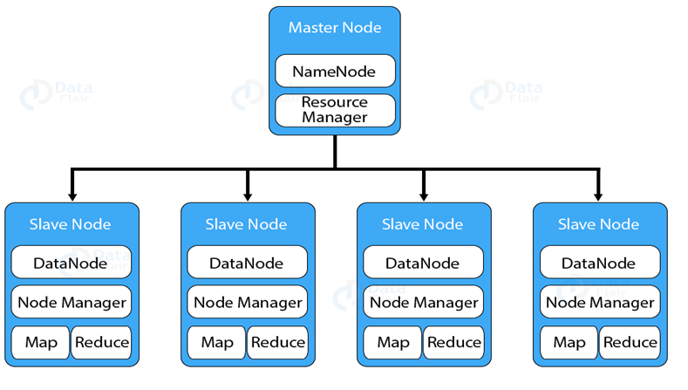

Slide 21
Storage of files
Files are split into blocks
Blocks are split across many machines at load time
Different blocks from the same file will be stored on different machines
Blocks are replicated across multiple machines
The NameNode keeps track of which blocks make up a file and where they are stored

Slide 22
Blocks
Block is the smallest unit of storage on a computer system. It is the smallest contiguous storage allocated to a file.
Replication Management
To provide fault tolerance HDFS uses a replication technique. In that, it makes copies of the blocks and stores in on different DataNodes. Replication factor decides how many copies of the blocks get stored. It is 3 by default but we can configure to any value.

Slide 23


Slide 24
In Hadoop 1 we have MapReduce but Hadoop 2 has YARN(Yet Another Resource Negotiator) and MapReduce version 2.
Hadoop 1 Hadoop 2
HDFSHDFSMap Reduce YARN / MRv2
Daemons:
Hadoop 1 Hadoop 2
Namenode Namenode
Datanode Datanode
Secondary Namenode Secondary Namenode
Job Tracker Resource Manager
Task Tracker Node Manager

Slide 25
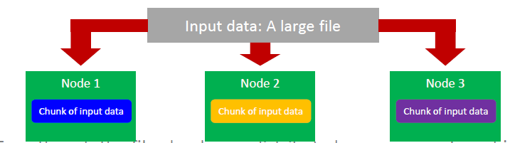
Data Distribution
In a MapReduce cluster, data is distributed to all the nodes of the cluster as it is being loaded in
An underlying distributed file systems (e.g., GFS) splits large data files into chunks which are managed by different nodes in the cluster.
Even though the file chunks are distributed across several machines, they form a single namesapce

Slide 26
MapReduce overview
In MapReduce, chunks are processed in isolation by tasks called Mappers
The outputs from the mappers are denoted as intermediate outputs (IOs) and are brought into a second set of tasks called Reducers
The process of bringing together IOs into a set of Reducers is known as shuffling process
The Reducers produce the final outputs (FOs)
Overall, MapReduce breaks the data flow into two phases, map phase and reduce phase

Slide 27
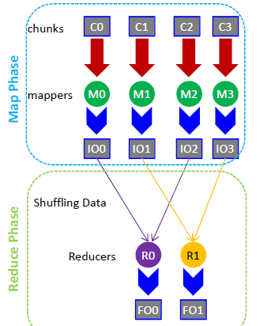

Slide 28
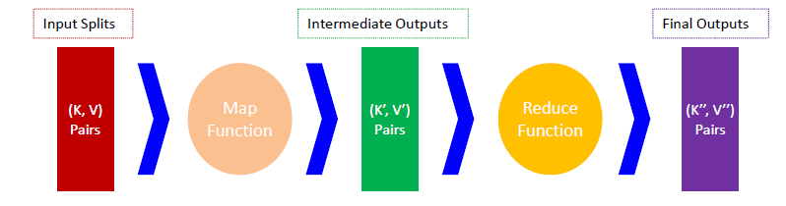
Keys and Values
The programmer in MapReduce has to specify two functions, the map function and the reduce function that implement the Mapper and the Reducer in a MapReduce program
In MapReduce data elements are always structured as key-value (i.e., (K, V)) pairs
The map and reduce functions receive and emit (K, V) pairs

Slide 29

Partitions
In MapReduce, intermediate output values are not usually reduced together
All values with the same key are presented to a single Reducer together
More specifically, a different subset of intermediate key space is assigned to each Reducer
These subsets are known as partitions.
Different colors represent different keys (potentially) from different Mappers
Partitions are the input to Reducers

Slide 30
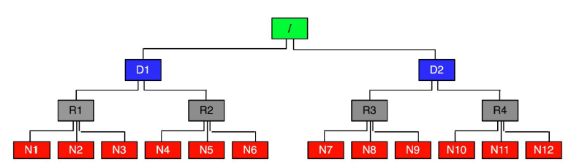
Network Topology In MapReduce
MapReduce assumes a tree style network topology
Nodes are spread over different racks embraced in one or many data centers
A salient point is that the bandwidth between two nodes is dependent on their relative locations in the network topology
For example, nodes that are on the same rack will have higher bandwidth between them as opposed to nodes that are off-rack

